Slide 1

AQua: A Solar-Powered Water Quality Monitoring and Recording System
Researchers:
Daligdig, Arianne Dale
Fuentespina, Jane

Slide 2

Introduction
Aquaculture
Globally - 179 million metric tons of fish were produced, of which 82 million were produced by aquaculture (FAO, 2020).
Philippines - 525.24 thousand metric tons volume of harvest
decreased by 0.2% from the 526.05 thousand metric tons (PSA, 2021).
Mindanao - about 2,869.78 metric tons were produced from aquaculture fisheries
15.2% lower compared to the catch of 3,382.20 metric tons (PSA-SOCCSKSARGEN, 2020).
Notes:
Aquaculture is one of the most booming industries in many nations globally, as demand for fish and fish-prepared foods grows every day. In 2018, 179 million metric tons of fish were produced, of which 82 million were produced by aquaculture (FAO, 2020).
In the Philippines during the first quarter of 2020, the volume of harvests from the aquaculture farms reached 525.24 thousand metric tons. It decreased by 0.2 percent from the 526.05 thousand metric tons produced during the same period in the previous year (PSA, 2021).
In Mindanao specifically in Region 12, about 2,869.78 metric tons were produced from aquaculture fisheries in the 2nd quarter of 2020 and this is about 15.2 percent lower compared to the catch of 3,382.20 metric tons in the same quarter last year (PSA-SOCCSKSARGEN, 2020).

Slide 3
According to BFAR-PHILMINAQ, the fish perform all its physiological activities in the water
Thus, water quality is the determining factor in the success or failure of an aquaculture operation.
At present, aqua farmers rely on manual testing to determine water conditions
Notes:
The aquaculture industry is facing many problems; and it is due to the sudden climatic fluctuation that leads to changes in water quality parameters.
According to BFAR-PHILMINAQ, the fish perform all its physiological activities in the water – breathing, excretion of waste, feeding, and reproduction.
Thus, water quality is the determining factor in the success or failure of an aquaculture operation. The continued degradation of water resources due to anthropogenic sources necessitates an improvement in sites for aquaculture using water quality as a basis.
At present, aqua farmers rely on manual testing to determine water conditions; and it consumes time and produces inaccurate readings because water quality parameters may alter with time.
These problems being faced by the Philippine government stem from a lack of clear responsibilities, overlapping institutional boundaries, duplication of work, and a lack of coordination among involved institutions. All water quality monitoring programs in the country are constrained somehow by available laboratory facilities, instruments, transportation, and human resources; and may collect data primarily through direct sampling or limited water quality parameters. (Japitana et al., 2018) Specific information about water conditions, which is required to develop management strategies, is particularly scarce. (Deutsch et al., 2005)

Slide 4
With this, the researchers proposed a study that builds a portable and energy-efficient on-site water quality monitoring and recording system that can deliver real-time data to the aqua farmers and government officials and record the current environmental status of the aquaculture sites for further analysis.
Notes:
This project will help prevent the water parameters from fluctuating to a dangerous level that affects the mortality rate of the organism. Also, this will help in addressing the decline of the production of fish in selected aquaculture sites in Mindanao, Philippines.

Slide 5

Power supply
traditional water quality monitoring systems
slow fish growth and fish kills in fisheries
AQua
Notes:
*Power supply has become an increasing problem in some of the existing water quality monitoring systems, where sensor nodes are deployed across several sites and can constitute the system's bottleneck. Using wires to connect nodes to power lines nearby is not practical because the nodes usually distribute in remote places where the total expense in connecting all these nodes is unbearable. Another option is to solely utilize a battery. The benefits are evident, but batteries have a short lifespan and cannot last for lengthy periods. Replacing exhausted batteries regularly is time-consuming. Using a solar panel to power the sensor node and a battery to recharge when solar power is insufficient (such as at night), this solution will save time and effort while also making the system more deployable.
*Apart from that, traditional water quality monitoring systems rely on short-range, high-power wireless technologies, which are inconvenient for wireless sensor nodes in a Wireless Sensor Network (WSN).
*Furthermore, slow fish growth and fish kills in fisheries are problems that every fish farmer faces in the aquaculture industry. Water quality is a critical factor that must be monitored from time to time when culturing any aquatic organism; however, most fish farmers do not consider it because traditional water testing and water sensors are done manually, expensive and difficult to use.

Slide 6
Energy-Efficient
Lower latency
Scalable
Notes:
As a result of these concerns, this proposed project provides a device designed to address energy difficulties in WSNs, as well as a low-cost, low-power, long-range, scalable water quality monitoring strategy based on the Zigbee protocol, which is significantly more efficient than many current systems.
This novel system that we proposed will speed-up the time needed to test the water parameters and has several advantages, including no carbon emissions, low power consumption, greater flexibility in deployment at a remote site, and so on.

Slide 7
develop a real-time water quality progress report for water treatment ensuring a safe natatory environment for aquaculture using Raspberry Pi.
Objectives
Notes:
1.3.1 General Objective
The main objective of this research is to develop a real-time water quality progress report for water treatment ensuring a safe natatory environment for aquaculture using Raspberry Pi.

Slide 8
Design and construct the AQua device
Monitor and measure the water parameters
Assess the accuracy of the results
Provide local power supply and collect the data
Simulate and analyze the quality parameters for quality control
Notes:
1.3.2 Specific Objectives
This research project aims to achieve the following:
Design and construct the AQua device using Raspberry Pi.
Monitor and measure the water pH, temperature, and turbidity using available sensors at remote places.
Assess the accuracy of the results when applied to a wide range of water conditions.
Provide local power supply to sensor nodes using solar energy and collect the data from various sensor nodes and send it to base stations by a wireless channel which are connected using Wireless Sensor Network technology like Zigbee.
Simulate and analyze the quality parameters for quality control using ThingSpeak and publish the corresponding record over the web for public information and further assessment of water resources.

Slide 9
Aquaculturists
Future Researchers
University
Researchers
Significance
Notes:
Significance of the Study
This research study, AQua: a solar-powered water quality monitoring and recording system is proposed in order to be significant to the following:
To Aquaculturists. The device will help the aquaculturist by delivering real-time data to the aqua farmers and government officials and record the current environmental status of the aquaculture sites for further analysis. This project will help prevent the water parameters from fluctuating to a dangerous level that affects the mortality rate of the organism. Also, this will help in addressing the decline of the production of fish in selected aquaculture sites in Mindanao.
To the Future Researchers. They can use this study as their reference to additionally extend the usage of Zigbee module, Raspberry Pi and ThingSpeak IoT in water quality monitoring and in other fields as well.
To the University. This study will be of use to the Mindanao State University particularly engineering students who suppose they might be intrigued and inspired to invoke more splendid thoughts, characterizations of innovative progressions that would be of future use to the College of Engineering with accomplishing its objective and to further develop the said water quality monitoring system.
To the Researchers. This study will be an opportunity for them to apply the knowledge and illustrations gained from subjects related to this study and help them further practice their decisive reasoning. Moreover, this will also give the researchers to be more exposed and gain experience as they need to be focused and hands-on in this study.

Slide 10
Scopes and Delimitations
Raspberry Pi
Zigbee module interface
pH, temperature, and turbidity of the water
Department of Environment and Natural Resources' (DENR) standard levels
Notes:
Scopes and Delimitations
This project's main objective is to create an onsite and energy-efficient IoT-based water quality monitoring and recording system using a Raspberry Pi. It focuses mainly on the sensor's and device's accuracy in contrast to typical laboratory equipment and the speed and range of data transmission via Zigbee module interface. Only the pH, temperature, and turbidity of the water will be measured by the device. The study's threshold values are solely based on Department of Environment and Natural Resources' (DENR) standard levels. This device is solely for determining the water quality of aquaculture industries in selected sites in Mindanao.

Slide 11
Definition of Terms
AQua Water Parameters
Aquaculture Water Pollution
Fishkill Water Quality
Raspberry Pi Wireless Sensor Network
Solar Energy Zigbee Module
ThingSpeak
Notes:
AQua- the name of the device that will monitor and record the water quality of Aquaculture sites in region 12
Aquaculture- is the practice of raising aquatic animals and plants in controlled and managed environments.
Fishkill- massive destruction of fish stocks in a specific area due to unacceptable or toxic water quality conditions in a specific aquatic environment.
Raspberry Pi- is a small form-factor single-board computer that can process simultaneously
Solar energy- the power source of the AQua device
ThingSpeak- an IoT platform for reviewing and visualizing water quality sensor results.
Water Parameters- are the ones monitored for water quality and it includes temperature, pH, and turbidity.
Water Pollution- contamination of the body of water that degrades water quality and makes it toxic to humans and the environment.
Water Quality- describes the condition of the water, including chemical, physical, and biological characteristics.
Wireless Sensor Network (WSN)- used for water quality monitoring it is collected by sensors and then transmitted to a server.
Zigbee module- for broadcasting and receiving sensor values.

Slide 12
Related Literatures

Slide 13
Aquaculture
Related Literatures
Notes:
Aquaculture is the world's fastest-growing food-production sector. It is the practice of raising, breeding, and harvesting aquatic animals and plants in controlled aquatic environments such as oceans, lakes, rivers, ponds, and streams. It also has inherent features that make it one of the most cost-effective and low-impact methods of producing high-quality protein for humans. Compared to traditional animal agricultural methods, these advantages include a significantly higher food conversion efficiency. All systems, on the other hand, must provide the same ecological functions, such as maintaining an acceptable culture temperature, ensuring enough oxygen levels, and removing dangerous waste products (Tidwell and Bright, 2018; Schramm and Grist, 2021)

Slide 14
Fish Kills
Related Literatures
Notes:
According to the BFAR, fishkill is defined as the "massive destruction of fish stocks in a specific area due to unacceptable or toxic water quality conditions in a specific aquatic environment." Some cases are caused by human activities, but natural causes account for roughly half of all cases worldwide. Some of the most common reasons include algal blooms and the related water quality issues, such as low oxygen or toxin development (Vera-ruiz, 2021).

Slide 15
Water Parameters
Related Literatures
Notes:
Water Parameters
Depending on the intended water parameters of interest, chemical, physical, and biological aspects of water can all be analyzed or monitored. Temperature, dissolved oxygen, pH, conductivity, ORP, and turbidity are just a few of the water quality metrics that are commonly measured or monitored.
2.1.2.1 pH
Extremely low or extremely high pH water is fatal. Only a few organisms can survive in water with a pH of below three or beyond eleven, and most fish will die if the pH is below four or above ten. Water that is somewhat acidic (low pH) can diminish the number of hatched fish eggs, irritate fish and aquatic insect gills, and damage membranes (Omer, 2019).
2.1.2.2 Temperature
The temperature of water is one of its most basic properties, and many other factors rely on it for accuracy. We can use temperature data to monitor thermal loading or discharge, as well as measure changes in the thermocline, which has an impact on the health of aquatic animals and critters. Many aquatic organisms are harmed by high temperatures because less oxygen dissolves in the water, clouds prohibit plants from creating enough oxygen through photosynthesis, and calm breezes inhibit turbulence and mixing of atmospheric oxygen with surface water. Warmer water has a lower oxygen solubility, which reduces oxygen delivery. Furthermore, because larger fish demand more oxygen than smaller fish, they usually perish first (Sallenave, 2013).
2.1.2.3 Turbidity
Suspended particles can block or harm fish gills, reducing disease resistance, growth rates, egg and larval maturation, and the efficacy of fish capture methods. Higher turbidity boosts water temperatures, which limits the amount of accessible food, because suspended particles absorb more solar heat. As a result, the concentration of dissolved oxygen (DO) can be lowered since warm water carries less dissolved oxygen than cold water (Omer, 2019).

Slide 16
Wireless Network System Technology
Related Literatures
Notes:
Recent technologies in wireless communications and electronics have brought the vision of Wireless Sensor Network (WSN) into reality which have increased the growth of low cost, low power and multi-functional sensors that are small in size and can communicate in short range. Each node consists of microcontrollers, memory and transceiver. The microcontrollers are used to execute tasks, data processing and assist the functionality of other components in the sensor node. For the memory, it is mainly used for data storage while the transceiver acts from the combination of transmitter and receiver functions. Natural phenomena data such as temperature, light, sound and pressure are collected by sensors and then transmitted to a server. These battery powered nodes are used to monitor and control the physical environment from remote locations. In the past few years, the applications of Wireless Sensor Network have been widely used and applied in medical, military, industrial, agricultural and environmental monitoring (Mohd, 2011).
In order to collect data about the surrounding environment, wireless sensor networks (WSNs) are made up of interconnected sensor nodes that interact wirelessly. Nodes are often low-power and distributed in a decentralized, ad hoc manner. Although WSNs have acquired a lot of traction, resource restrictions in memory, compute, battery life, and bandwidth have placed some major limitations when it comes to establishing security. Privacy, control, and availability are all targets of a variety of assaults. (Patil & Chen, 2017)

Slide 17
Related Studies

Slide 18
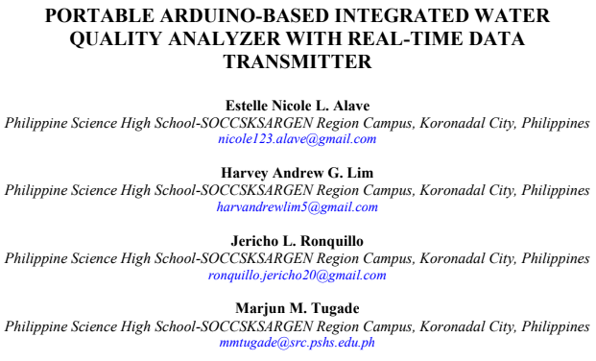
DOI: 10.20319/mijst.2020.63.5871
Notes:
published on December 2020

Slide 19
Safe drinking water
TDS, ph, turbidity
GSM module
Notes:
Their study focused on providing a safe drinking water by developing the WQMS.
Their system measured the following water parameters that is very important in determining the quality of the water.
Their device utilized GSM module which sends the information on all the parameters analyzed at a specific time interval
and warning if any parameters’ values exceed the permissible levels.
Despite their substantial findings, they recommended to the future researchers to use an environmentally friendly power
source that can supply the needed voltage requirements for the prototype to be efficient.

Slide 20
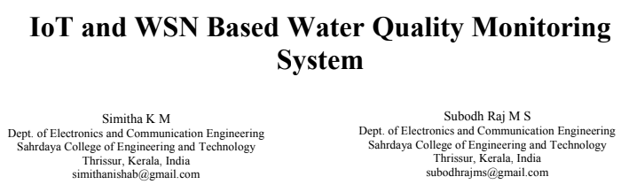
ISBN: 978-1-7281-0167-5
Notes:
published on December 2019

Slide 21
Smart City
Temperature, ph, turbidity, dissolved oxygen
LoRa module
Notes:
Their study focused on integrating the WQMS in Smart City.
Their system measured the following water parameters that is very important in determining the quality of the water.
Their used the LoRa module (low cost, low power, long range) for transmitting and receiving sensor values, and ThingSpeak for examining and visualizing water quality sensor values which have been uploaded.
Also, they emphasized in their findings that LoRa provides long range wireless communication cannot be achieved in many existing water quality monitoring systems using ZigBee, Bluetooth, and WiMAX etc.

Slide 22
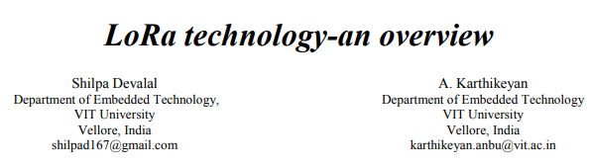
DOI: 10.1109/ICECA.2018.8474715
Notes:
published on December 2018

Slide 23
Smart City
Temperature, ph, turbidity, dissolved oxygen
LoRa module
Notes:
They mentioned that one of the limitations of Lora is it’s not suited for real time applications that require
lower latency.
With high latency, you’ll see a delay between the controller input and the resulting jump on your screen
because the trip to the server and back takes longer.

Slide 24
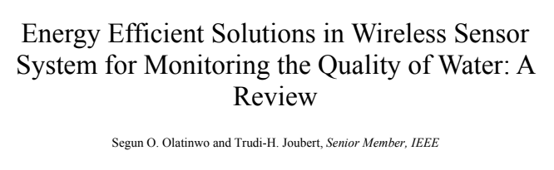
DOI: 0.1109/JSEN.2018.2882424,
Notes:
published on December 2018

Slide 25
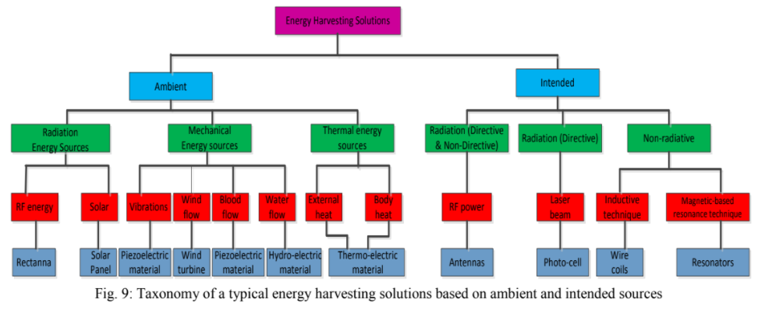
Notes:
published on December 2018

Slide 26
Safe drinking water
Oxygen level, ph, turbidity
VB & MATLAB
Notes:
They concluded that using solar energy provides several advantages such as no carbon emissions, low power consumption,
greater flexibility in deployment at a remote site, and so on.

Slide 27
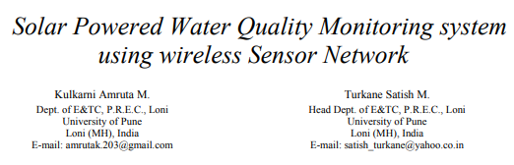
DOI: 10.1109/iMac4s.2013.6526423
Notes:
published on December 2018

Slide 28
System Design and Layout
Methodology

Slide 29
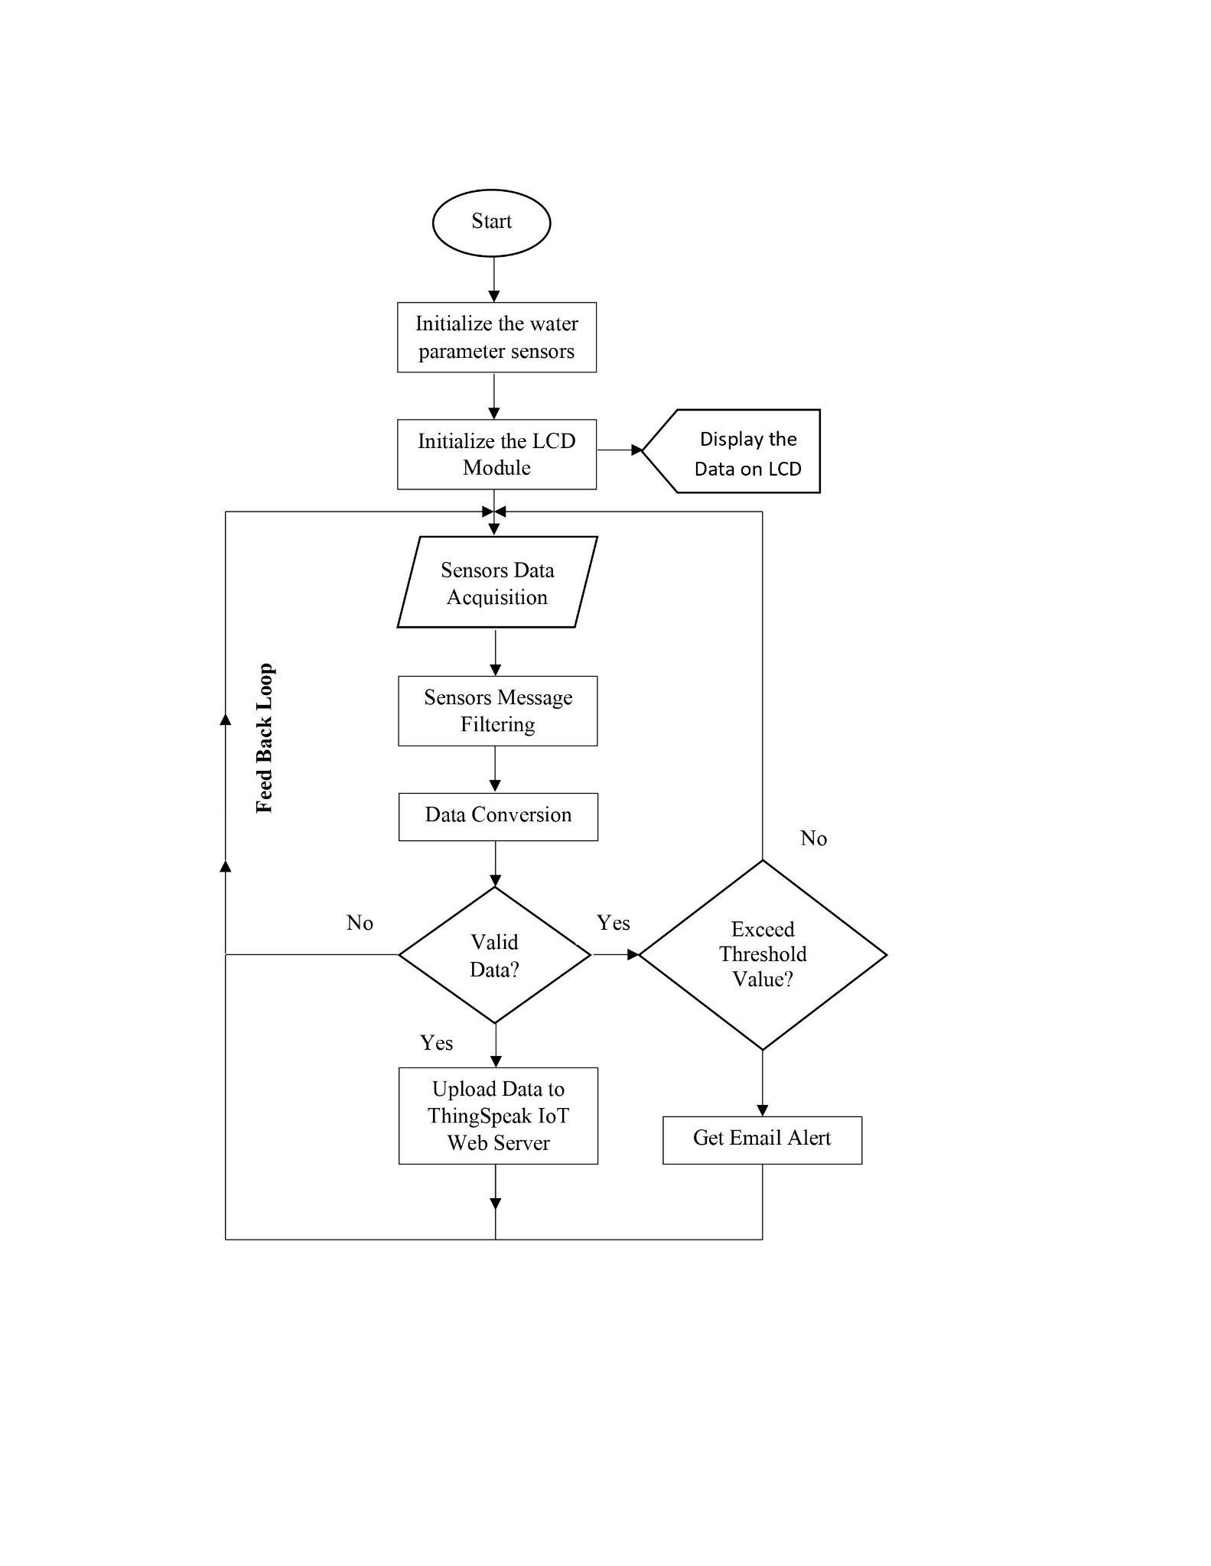
Notes:
The water parameter sensing node integrates sensors in real-time water quality monitoring and recording systems. These sensor values are displayed through the LCD monitor. Moreover, the data collected by the sensors is sent to the base stations by a wireless sensor network technology called Zigbee then transfers it to the ThingSpeak server through the ESP32 Wi-Fi gateway module. The quality parameters acquired are then stored, simulated and analyzed for quality control using ThingSpeak and publish corresponding records over the web for public information and further assessment of water parameters. An alarm notification will be sent through email using MATLAB or IFTTT programming if any of the parameters' values exceed the permissible levels.

Slide 30
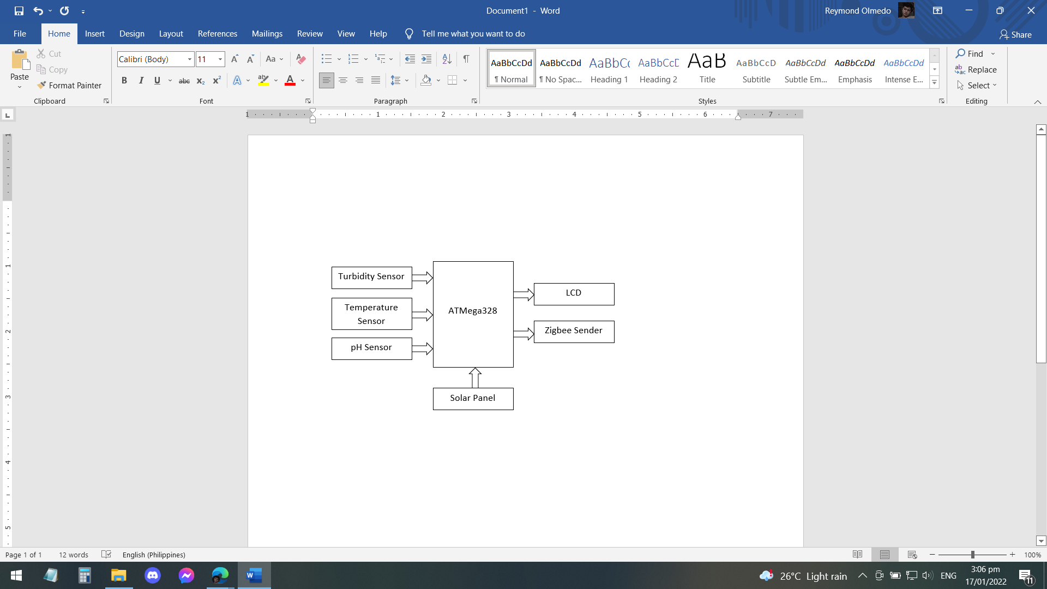
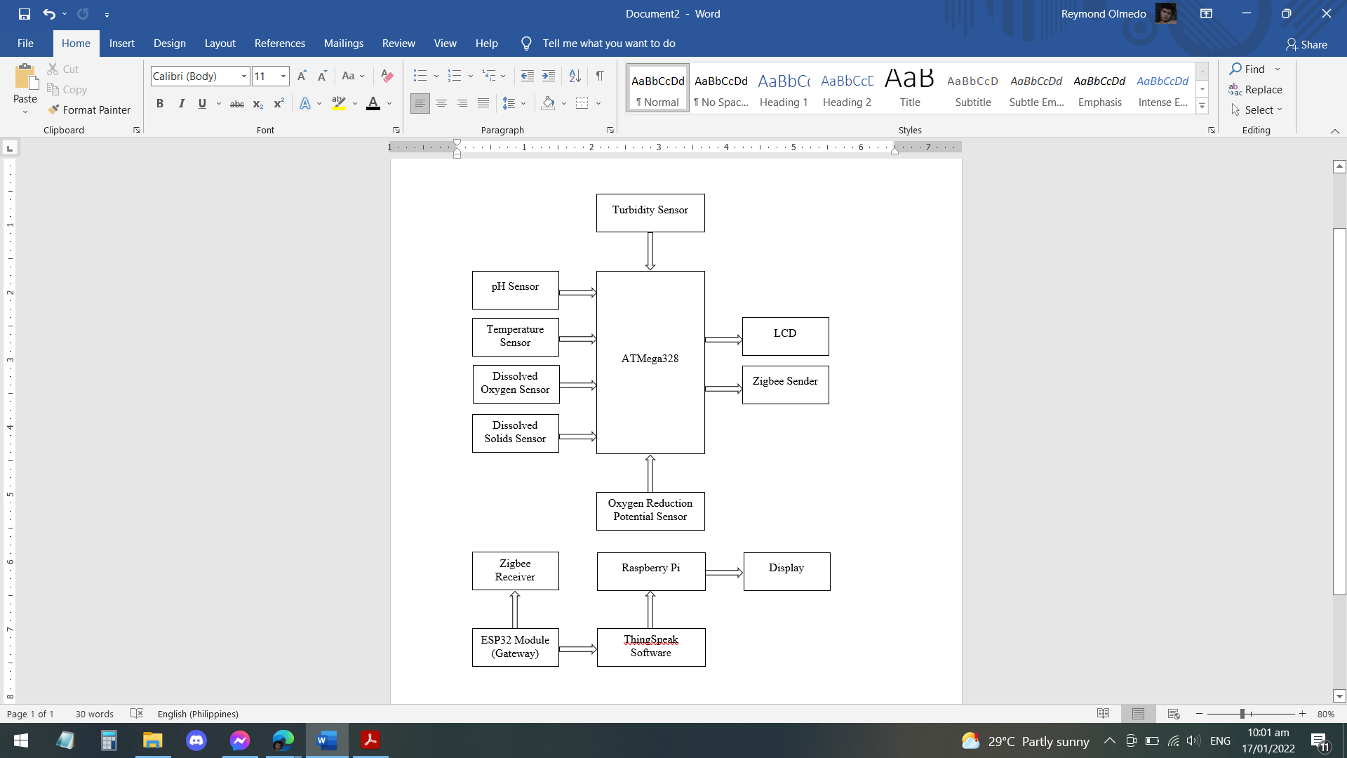
Notes:
The whole block diagram of the study is shown in Figure 3.2. The solar cell power supply gives power to the sensors, Raspberry Pi, ATMega328 microcontroller, ESP32 gateway module, and Zigbee module. The sensors are the pH sensor, temperature, and turbidity sensor. The Zigbee module will be used to connect the nodes and base station. The data obtained by various sensors on the node side will be sent to the base station where the data can be displayed in a visual manner and analyzed using ThingSpeak.

Slide 31
Construction & Assembly
Methodology

Slide 32
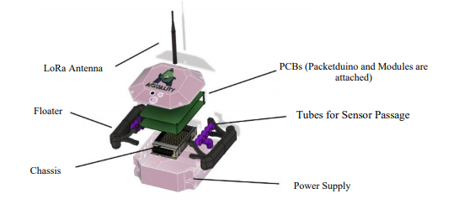
Notes:
The AQua device contains three sensors (namely the pH sensor, the temperature sensor, and the turbidity sensor) which are connected to one main microcontroller (Raspberry Pi) together with the Zigbee module. The case of the device is box-shaped and will be made out of acrylic due to its low cost material, water resistance ability, and well-known availability. It houses all the main parts of the device. The two tubes on each side function as a floating device. The pipes on each side are outlets for the sensor and are covered by mesh to avoid fish eating the sensors or bumping into them. Figure 3.3 shows the inspiration of the AQua device related to its illustration and its parts.

Slide 33
Technical Descriptions
Methodology

Slide 34
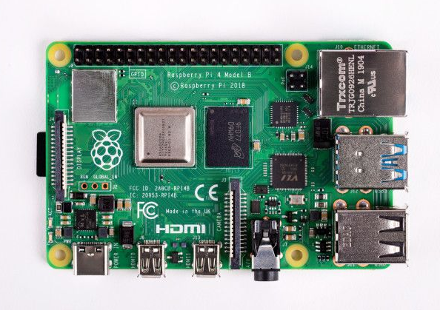
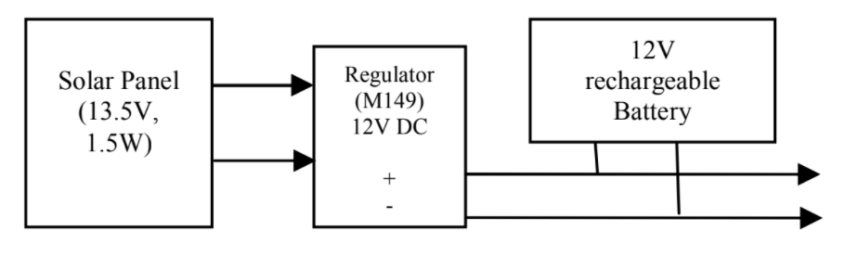
Raspberry Pi
Solar Panel Power Regulation and Storage

Slide 35
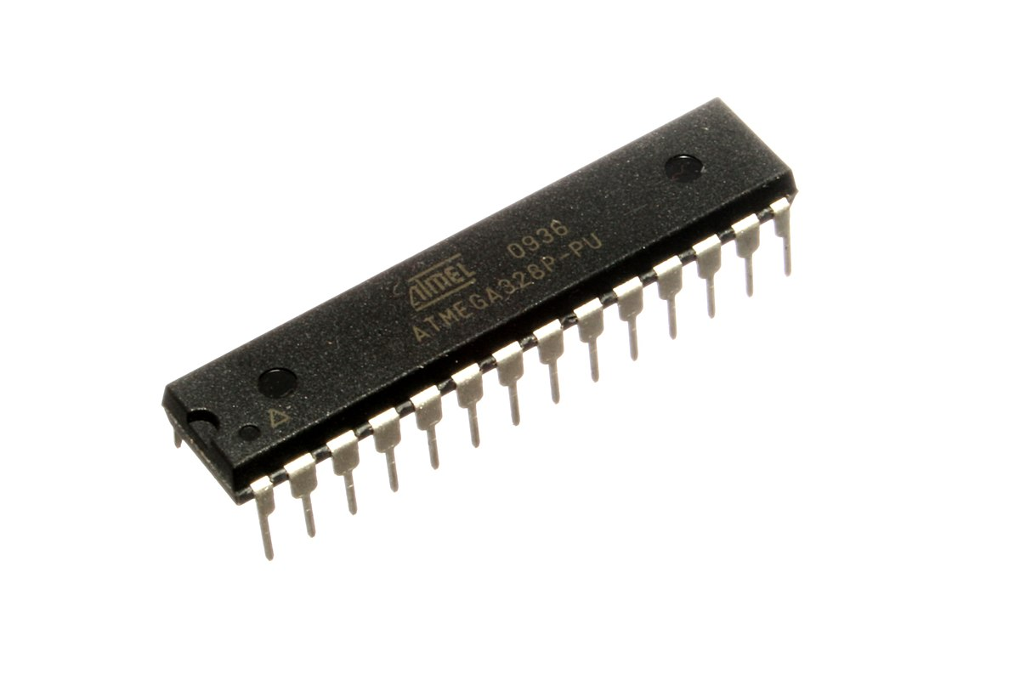
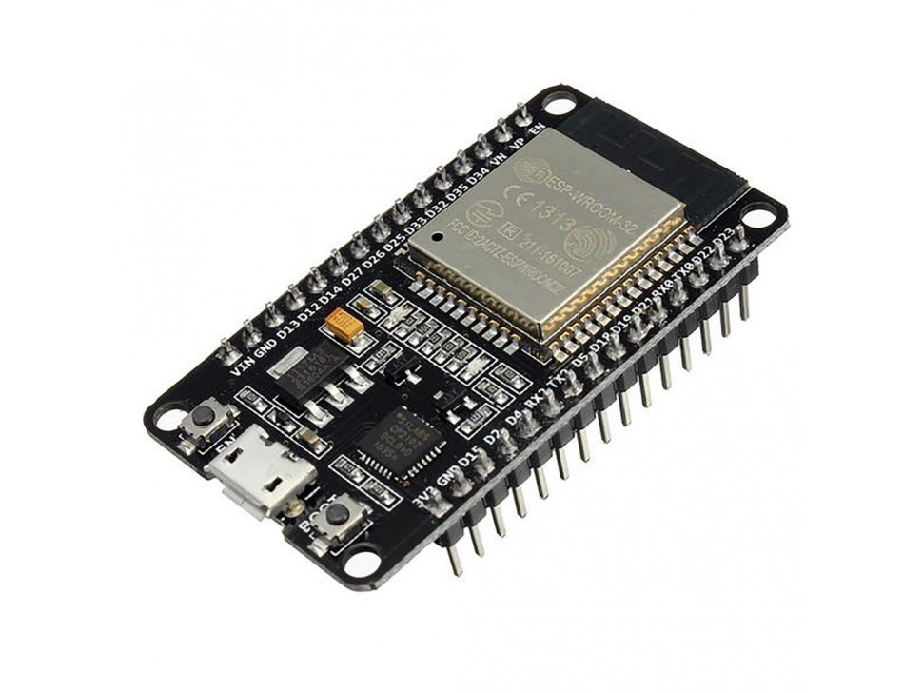
ATMega 328
ESP32 WiFi Module

Slide 36
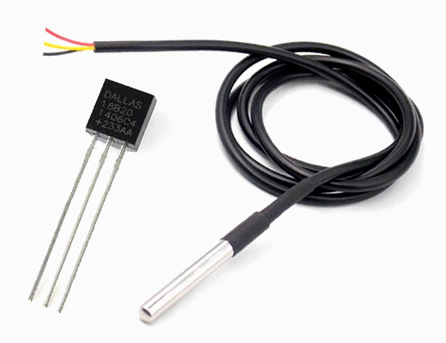
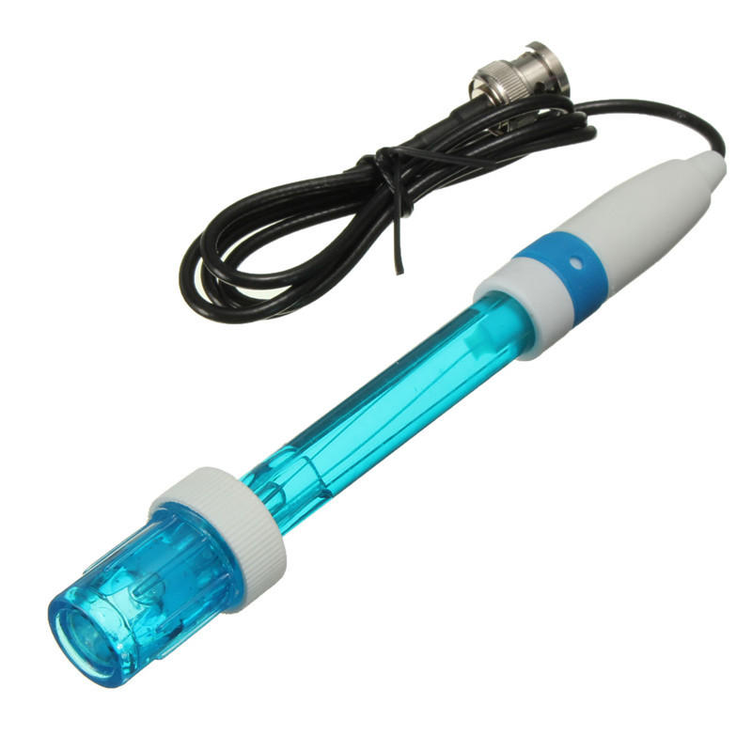
DSI8B20 Temperature Sensor
pH Sensor Module E201-C-9

Slide 37
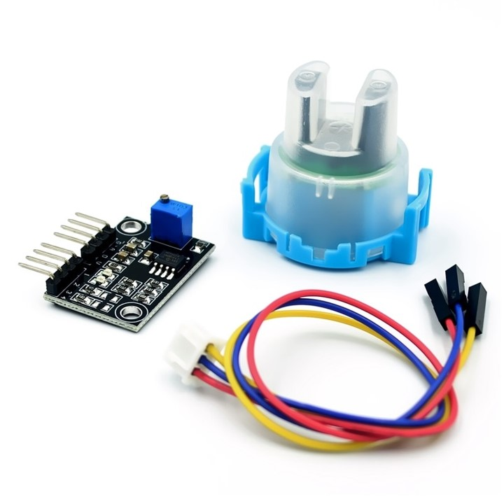
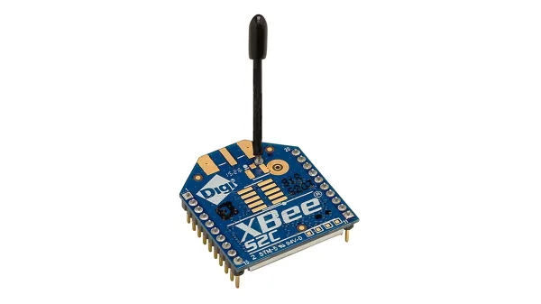
TS-300B Turbidity Sensor
Zigbee Module

Slide 38


Slide 39
Device Accuracy Test
Methodology
Notes:
The collected data was compared against the traditional way of data gathering for each parameter to ensure that the results were credible. To be considered accurate, each datum obtained by the gadget must be within 5% of the traditional method's test findings (Alave et al, 2020).

Slide 40
References
Alave, E. N. L., Lim, H. A. G., Ronquillo, J. L., & Tugade, M. M. (2020). PORTABLE ARDUINO-BASED INTEGRATED WATER QUALITY ANALYZER WITH REAL-TIME DATA TRANSMITTER.
Boyd, C., 2013. Reference Module in Earth Systems and Environmental Sciences. Elsevier.
Das, B., & Jain, P. C. (2017, July). Real-time water quality monitoring system using Internet of Things. In 2017 International conference on computer, communications and electronics (Comptelix) (pp. 78-82). IEEE.
Deutsch, W. G., Busby, A. L., Orprecio, J. L., Bago-Labis, J. P., & Cequina, E. Y. (2005). Community-based hydrological and water quality assessments in Mindanao, Philippines. Forests Water & People in the Humid Tropics, 134-149.
Devalal, S., & Karthikeyan, A. (2018, March). LoRa technology-an overview. In 2018 Second International Conference on Electronics, Communication and Aerospace Technology (ICECA) (pp. 284-290). IEEE.

Slide 41
References
FAO. (2020). STATE OF WORLD FISHERIES AND AQUACULTURE 2020 : sustainability in action. Food & Agriculture Org.
FAO Fisheries & Aquaculture. (n.d.). Www.fao.org. Retrieved January 7, 2022, from https://www.fao.org/fishery/en/countrysector/naso_philippines
Fisheries Situation Report, January to arch 2021 | Philippine Statistics Authority. (n.d.). Psa.gov.ph. Retrieved December 15, 2021, from https://psa.gov.ph/content/fisheries-situation-report-july-september-2021-0
Satish, T., & Amruta, K. (2013). Solar powered water quality monitoring system using wireless sensor network. In IEEE Conference on Automation, Computing, Communication, Control and Compressed sensing, IEEE (pp. 281-285).
Mohd. Ezwan Jalil. (2011). Positioning and Location Tracking Using Wireless Sensor Network (Doctoral dissertation, Universiti Teknologi Malaysia).

Slide 42
References
Nasirudin, M. A., Za'bah, U. N., & Sidek, O. (2011, September). Fresh water real-time monitoring system based on wireless sensor network and GSM. In 2011 IEEE Conference on Open Systems (pp. 354-357). IEEE.
Olatinwo, S. O., & Joubert, T. H. (2018). Energy efficient solutions in wireless sensor systems for water quality monitoring: A review. IEEE Sensors Journal, 19(5), 1596-1625.
Omer, N. H. (2019). Water quality parameters. Water quality-science, assessments and policy, 18.
Patil, H., & Chen, T. (2017). Wireless Sensor Network Security. Computer And Information Security Handbook, 317-337. doi: 10.1016/b978-0-12-803843-7.00018-1
Sallenave, R. (2013). Understanding and preventing fish kills in your pond. NM State University, Cooperative Extension Service.

Slide 43
References
Schramm, D., & Grist, C. (2021). BUILDING SITE SELECTION TO CONSERVE ENERGY BY OPTIMIZING TOPOCLIMATIC BENEFITS: A Possible Use for Computer-Based Data Manipulation and Mapping Systems. In Energy Resources and Conservation Related to Built Environment (pp. 308-318). Pergamon.
Simitha, K. M., & Raj, S. (2019, June). IoT and WSN based water quality monitoring system. In 2019 3rd International conference on Electronics, Communication and Aerospace Technology (ICECA) (pp. 205-210). IEEE.
SOCCSKSARGEN REGION’s 2nd QUARTER 2020 FISHERIES PRODUCTION UP BY 23.0 PERCENT | Philippine Statistics Authority SOCCSKSARGEN Region. (2020). Psa.gov.ph.http://rsso12.psa.gov.ph/article/soccsksargen-region%E2%80%99s-2nd-quarter-2020-fisheries-production-230-percent
Tidwell, J. H., & Bright, L. A. (2019, January 1). Freshwater Aquaculture (B. Fath, Ed.). ScienceDirect; Elsevier. https://www.sciencedirect.com/science/article/pii/B9780124095489106189

